Slide 1
AWT EVENT HIERARCHY

Slide 2
Abstract Windowing Toolkit (AWT): Sun's initial effort to create a set of cross-platform GUI classes. (JDK 1.0 - 1.1)
  Maps general Java code to each operating system's real GUI system.
  Problems: Limited to lowest common denominator; clunky to use.

Slide 3
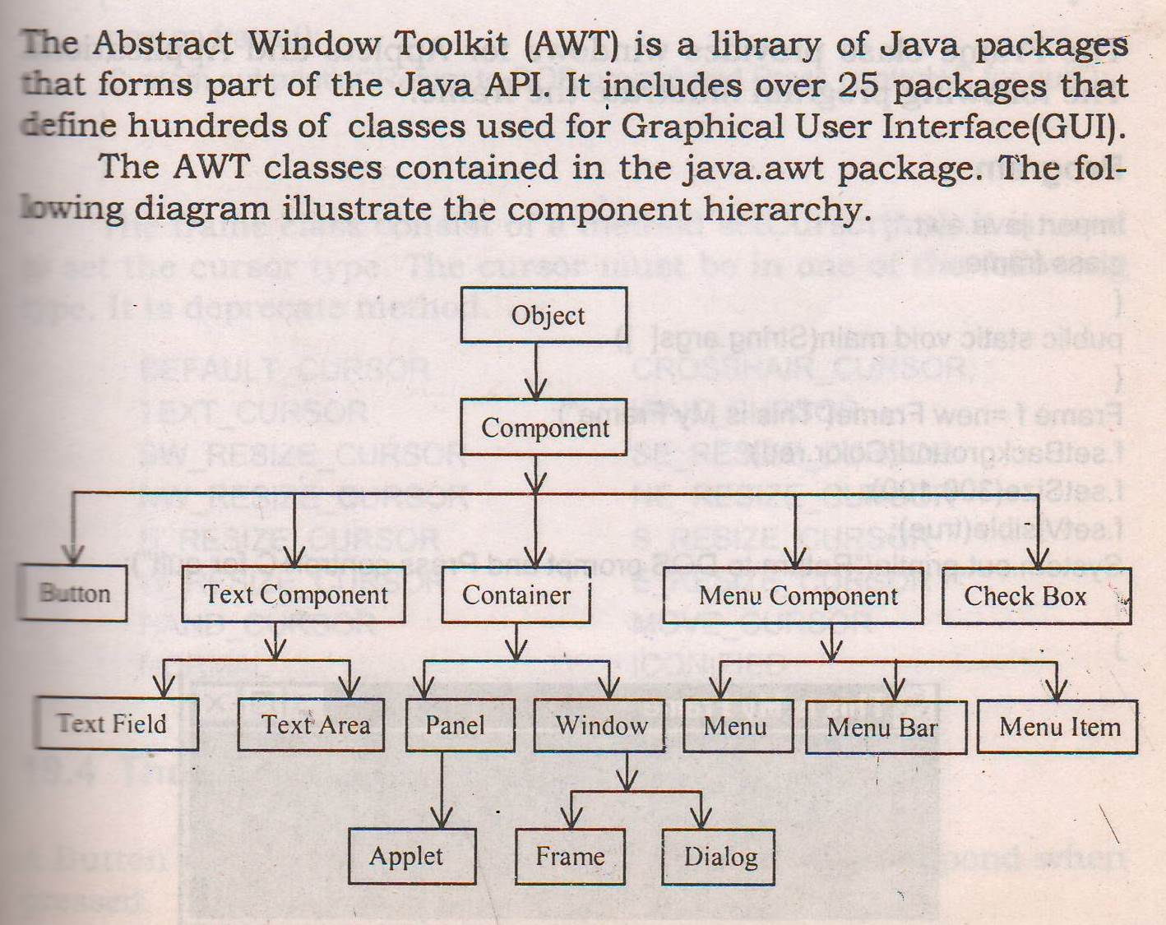

Slide 4
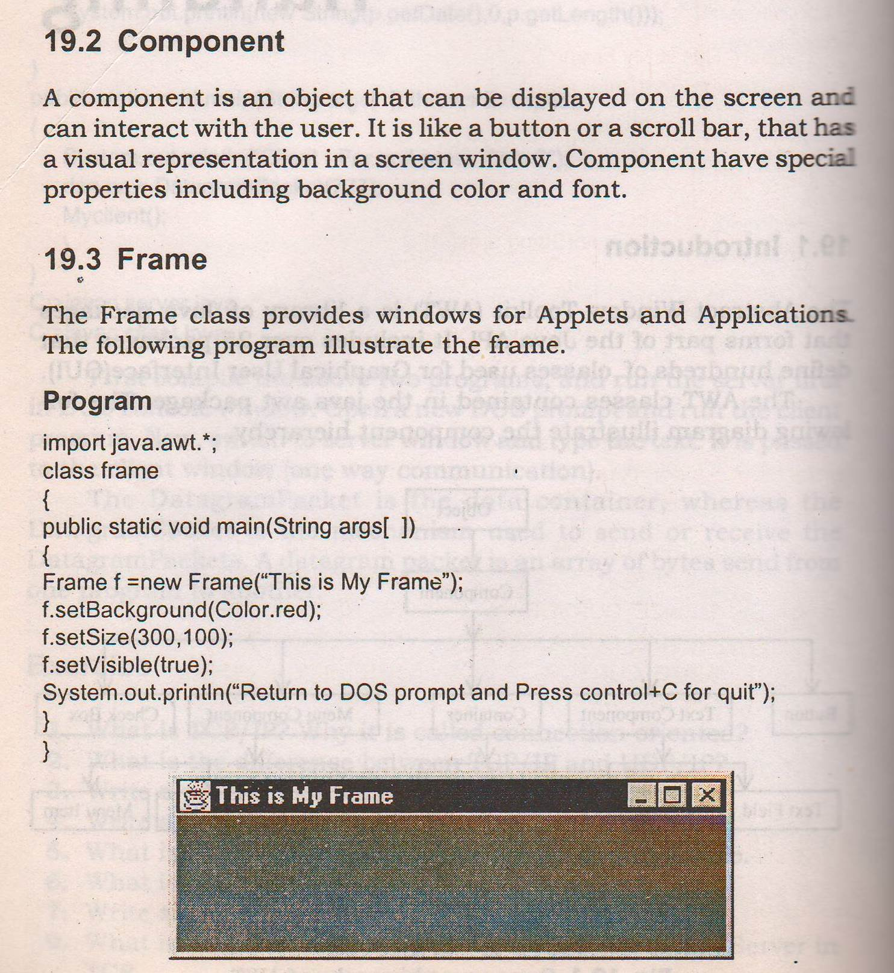

Slide 5
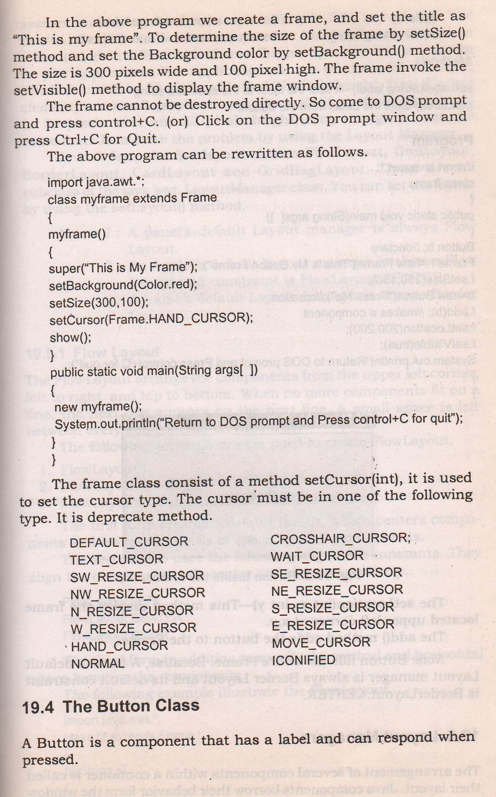

Slide 6
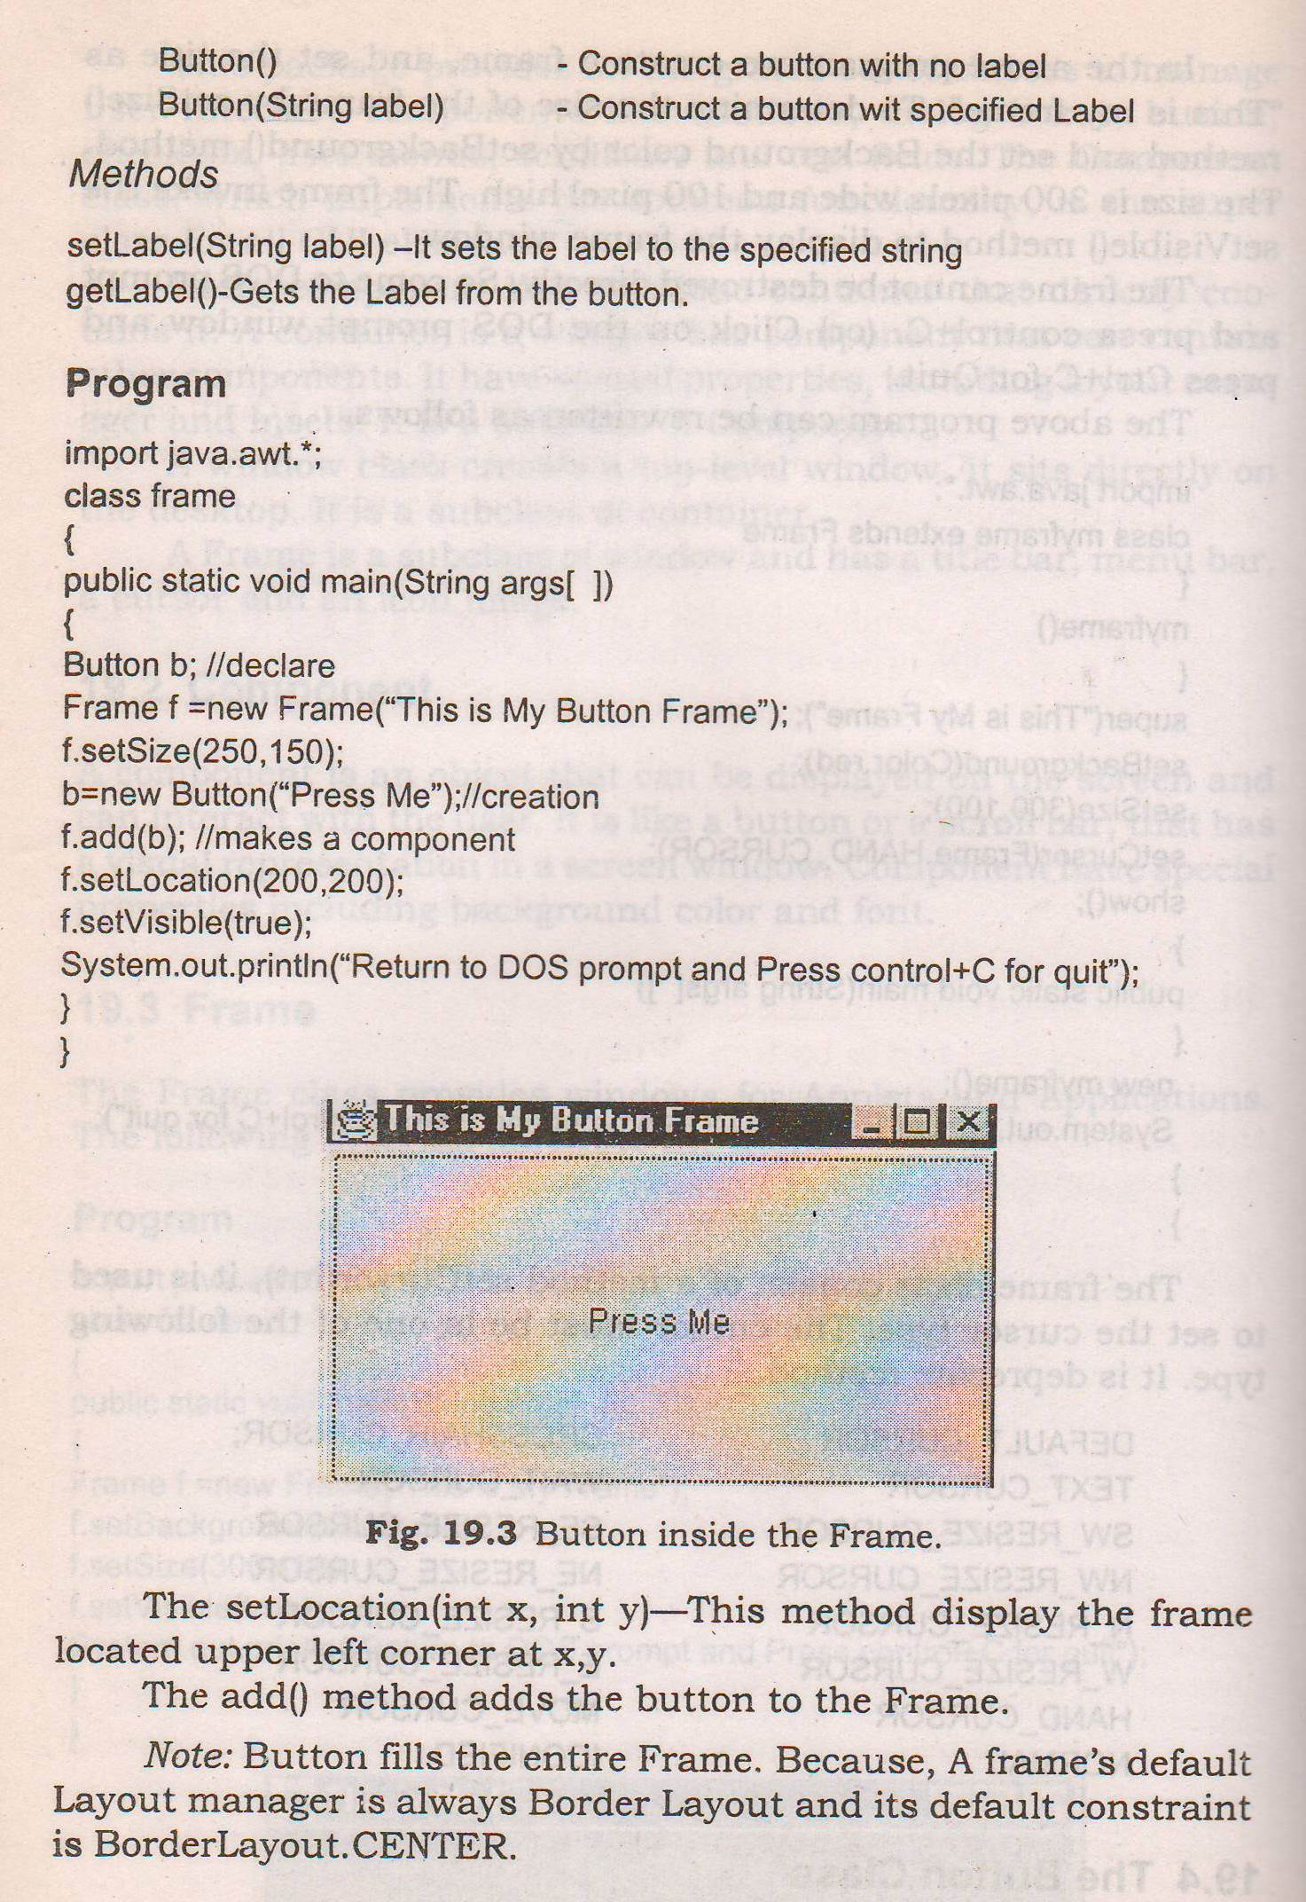

Slide 7
AWT CONTROLS

Slide 8
AWT stands for Abstract Window Toolkit.
It is used to build Graphical User Interfaces(GUI) for our applications.
Controls are components that allow a user to interact with your application in various ways. e.g., a push button.
A Layout manager automatically positions components within a container.
Thus the appearance of a window is determined by a combination of the controls that it contains and the layout manager used to position them.

Slide 9
AWT supports the following types of controls:
  Labels
  Buttons
  Check boxes
  Choice lists
  Lists
  Scroll bars
  Text Field
  Text Area
All these controls are subclasses of Component.

Slide 10
A control is added to a window by calling add( ) method which is defined by Container.Its signature is :
Component add(Component compObj)
Here, compObj is an instance of the control that is to be added.
A reference to the compObj is returned.
Once a control has been added, it will automatically be visible whenever its parent window is displayed.
remove() method is used to remove a control from a window. Its signature is :
void remove(Component obj)
Here, obj is a reference to the control that is to be removed.

Slide 11
Labels
A label is an object of type Label, and it contains a string, which it displays.
Labels are passive controls that do not support any interaction with the user.
Label defines the following constructors :
Label( )
Label(String str) // label string left justified
Label(String str, int how)
Here, how is the alignment-specifier. The value of how can be Label.LEFT, Label.CENTER, Label.RIGHT.

Slide 12
Methods:
void setText(String str) // sets new text to str
String getText( ) // gets the label string
void setAlignment(int how) // sets label alignment
int getAlignment( ) // gets the label alignment

Slide 13
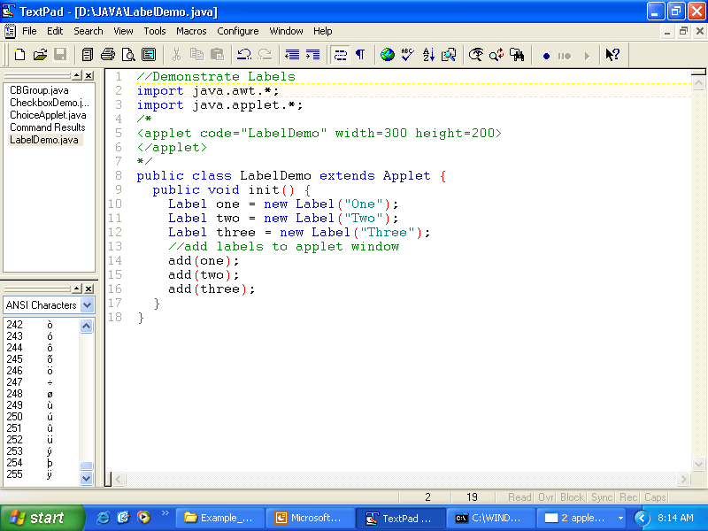
// Demonstrate Labels

Slide 14
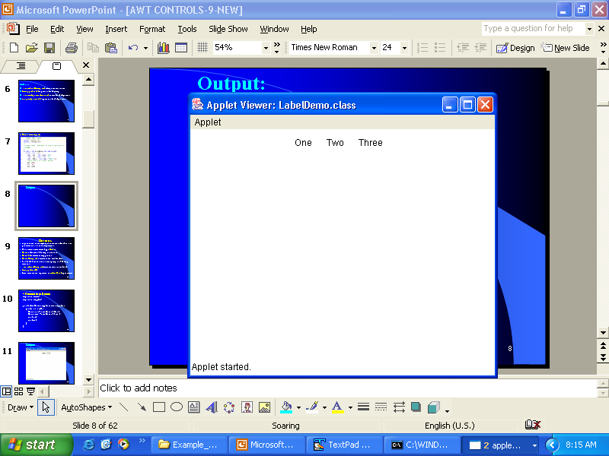
Output:

Slide 15
Buttons
A push button is a component that contains a label and that generates an event when it is pressed.
Push buttons are objects of type Button.
Button defines the following constructors :
Button( ) // creates an empty button
Button(String str) // creates button with label str
The label of a button can be set or get by the following methods :
void setLabel(String str) // str becomes the new label
String getLabel()
Each time a button is pressed, an ActionEvent is generated.

Slide 16
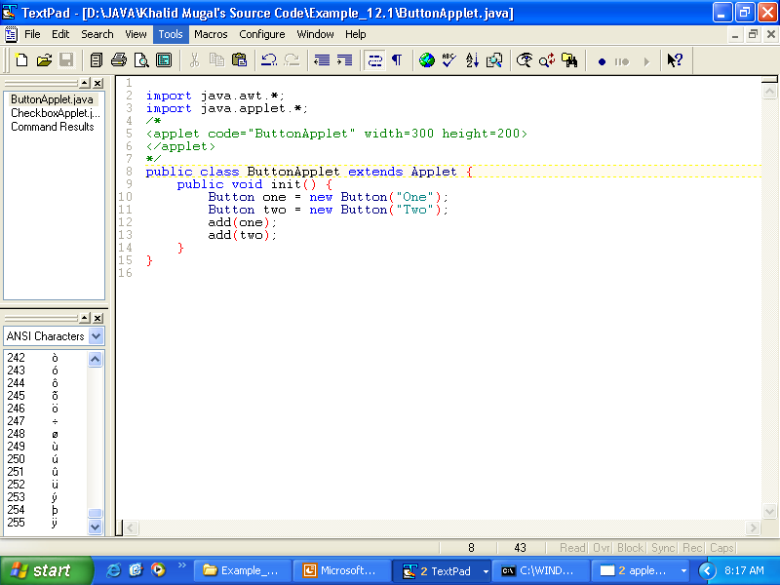
// Demonstrate Buttons

Slide 17
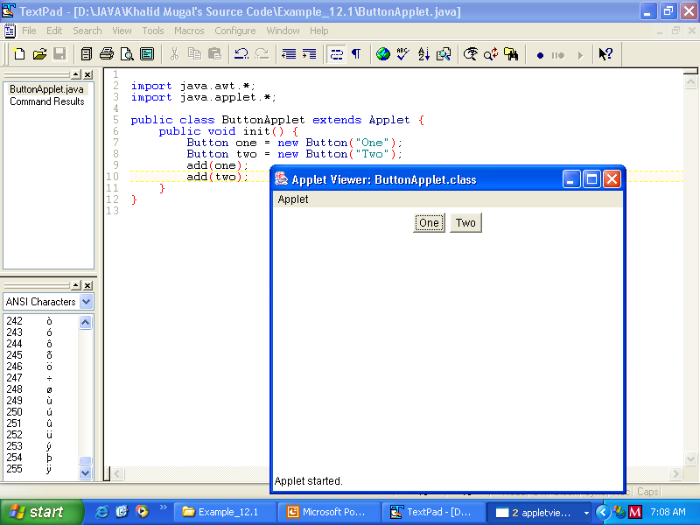
Output:

Slide 18
Check boxes
A check box is a control that is used to turn an option on or off.
Checkboxes can be used individually or as part of a group.
A checkbox can be incorporated in a CheckboxGroup to implement radio buttons.
Checkboxes are objects of the Checkbox class.
Checkbox supports following constructors :
Checkbox( )
Creates a checkbox whose label is initially blank and whose state is unchecked.
Checkbox(String str)
Creates a checkbox whose label is specified by str and whose state is unchecked.

Slide 19
Contd..
Checkbox(String str, boolean on )
If on is true, the checkbox is initially checked;otherwise, it is unchecked.
Checkbox(String str, boolean on, CheckboxGroup cbGroup )
Creates a checkbox whose group is cbGroup.If this checkbox is not part of a group, then cbGroup must be null.
Methods :
boolean getState() //returns the current state of the checkbox

Slide 20
Contd..
void setState(boolean on)
Sets the state of the checkbox.if on is true, it is checked; otherwise, unchecked.
String getLabel()
returns the label of the checkbox
void setLabel(String str)
Sets the label of the checkbox to str.
Each time a checkbox is selected or deselected, an ItemEvent is generated.

Slide 21
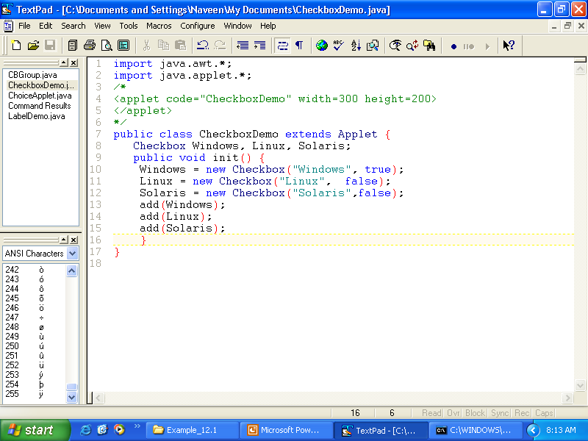
// Demonstrate check boxes.

Slide 22
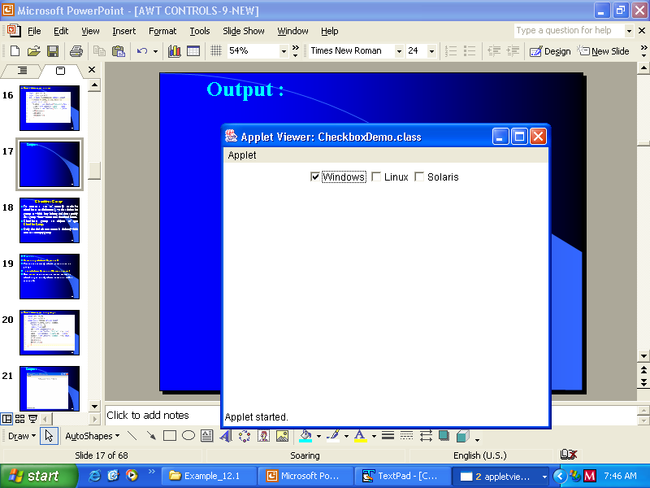
Output :

Slide 23
CheckboxGroup
To create a set of mutually exclusive checkboxes (radio buttons), we first define the group to which they belong and then specify that group when we construct the check boxes.
Checkboxes groups are objects of type CheckboxGroup.
Only the default constructor is defined,which creates an empty group.

Slide 24
Methods :
Checkbox getSelectedCheckbox()
Returns the currently selected checkbox in the group.
void setSelectedCheckbox(Checkbox which)
Here, which is the checkbox which we want to select.The previously selected checkbox will be turned off.

Slide 25
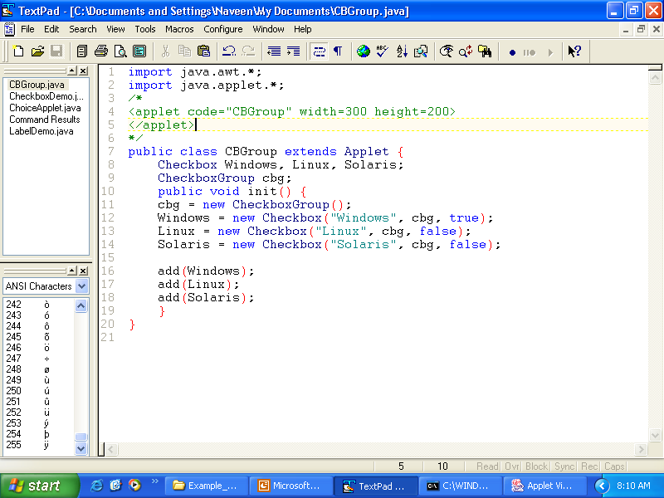
// Demonstrate check box group.

Slide 26
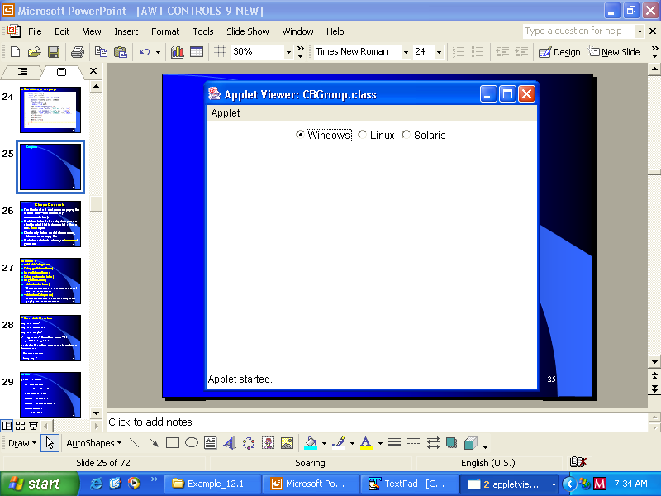
Output :

Slide 27
Choice Controls
The Choice class is used to create a pop-up list of items from which the user may choose(combo box).
Each item in the list is a string that appears as a left-justified label in the order it is added to the Choice object.
Choice only defines the default constructor, which creates an empty list.
Each time a choice is selected, an ItemEvent is generated.

Slide 28
Methods :
void add(String name)
String getSelectedItem()
int getSelectedIndex()
String getItem(int index)
int getItemCount()
void select(int index)
  Makes the item at the given position in the pop-up menu the current choice
void select(String name)
  Makes the item with the argument string in the pop-up menu the current choice

Slide 29
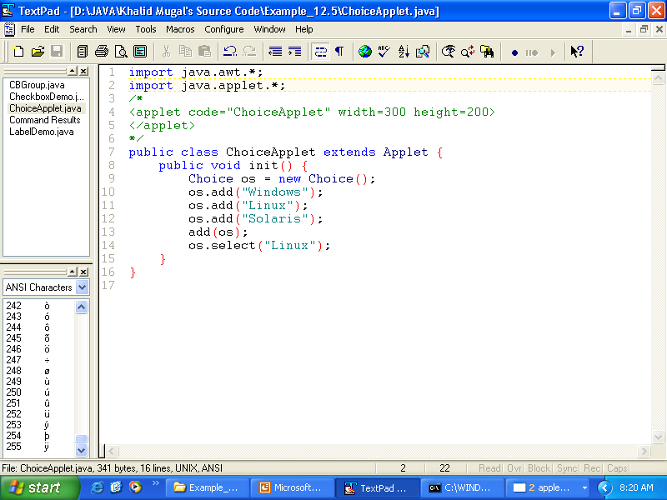
// Demonstrate Choice lists.

Slide 30
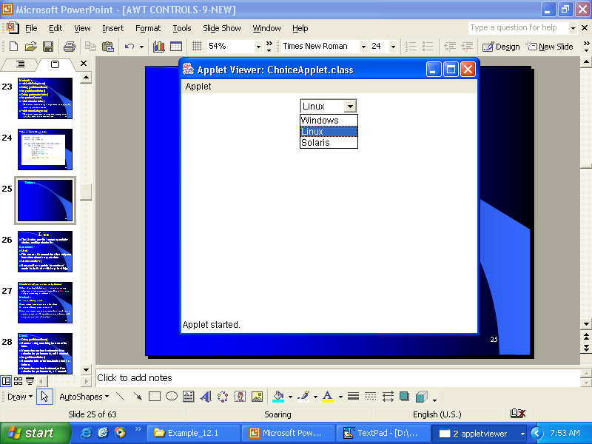
Output :

Slide 31
Lists
The List class provides a compact, multiple-choice, scrolling selection list.
Constructors :
List()
This creates a List control that allows only one item to be selected at any one time.
List(int numRows)
Here, numRows specifies the number of entries in the list that will always be visible.

Slide 32
List(int numRows, boolean multipleSelect)
Here, if multipleSelect is true, then the user may select two or more items at a time. If it is false, then only one item may be selected.
Methods :
void add(String name)
Adds item name at the end of the list.
void add(String name, int index)
Adds the item name at the particular index.Indexing begins at zero and –1 specifies that the element will be added at the end of the list.

Slide 33
Contd..
String getSelectedItem()
Returns a string containing the name of the item.
If more than one item is selected or if no selection has yet been made, null is returned.
int getSelectedIndex()
Return the index of the item. The first item is at index 0.
If more than one item is selected, or if no selection has yet been made, -1 is returned.

Slide 34
Contd..
String[ ] getSelectedItems()
Returns an array containing the names of the currently selected items.
int[ ] getSelectedIndexes()
Returns an array containing the indexes of the currently selected items.
int getItemCount()
Returns the number of items in the list.
void select(int index)
String getItem(int index)

Slide 35
Contd..
Each time a List item is double-clicked, an ActionEvent object is generated.
Each time a List item is selected or deselected with a single click, an ItemEvent object is generated.

Slide 36
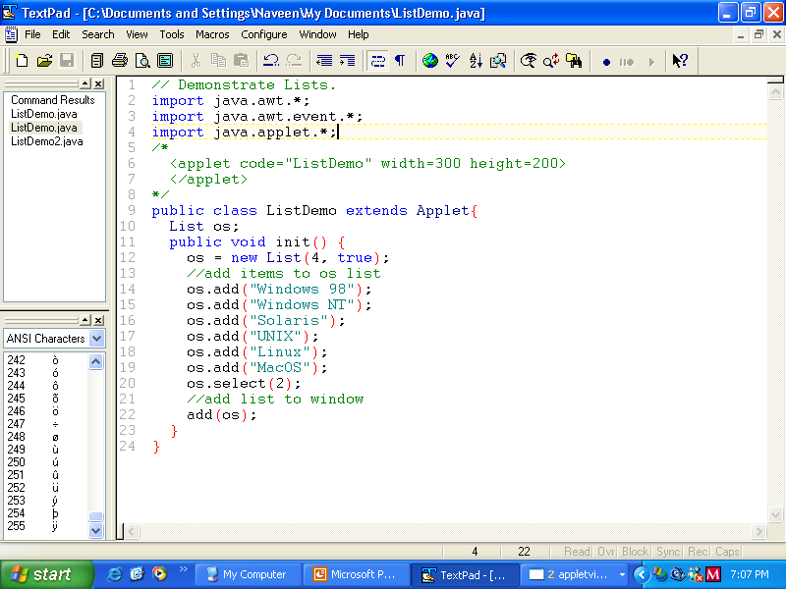
// Demonstrate Lists.

Slide 37
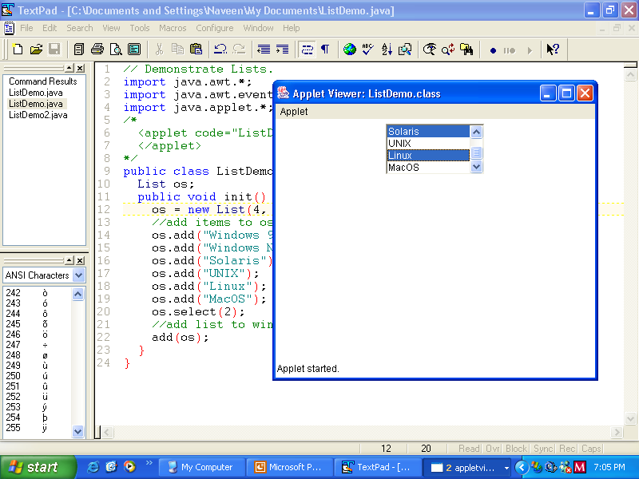
Output :

Slide 38
Scroll Bars
Scroll bars are used to select continuous values between a specified minimum and maximum.
They may be oriented vertically or horizontally.
Scrollbar defines the following constructors :
Scrollbar()
This creates a vertical scrollbar.
Scrollbar(int style)
Here, if style is Scrollbar.HORIZONTAL, a horizontal scrollbar is created.
If style is Scrollbar.VERTICAL, a vertical scrollbar is created.

Slide 39
Contd..
Scrollbar(int style, int initialValue, int thumbSize, int min, int max)
Here, initialValue is the initial value of the scrollbar.
thumbSize is the number of units represented by the slider.
min and max are the minimum and maximum values of the scrollbar.
If first two constructors are used to construct a Scrollbar, then its parameters are set by using the setValues() method. Its signature is :
void setValues(int initialValue, int thumbSize, int min, int max)

Slide 40
Contd..
int getValue()
Returns the current value of the scrollbar.
void setValue(int newValue)
Sets the value of the Scrollbar to newValue.
int getMinimum()
Returns the minimum value of the scrollbar.
int getMaximum()
Returns the maximum value of the scrollbar.

Slide 41
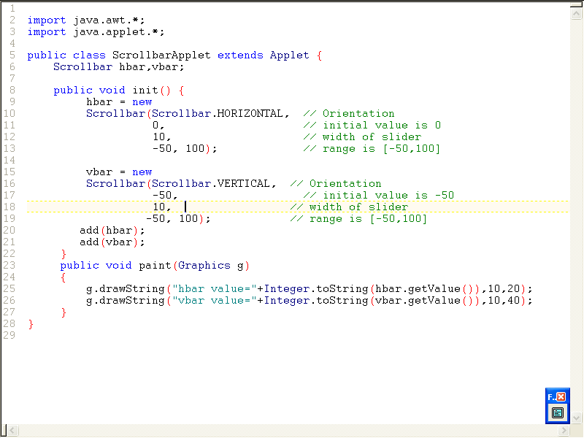

Slide 42
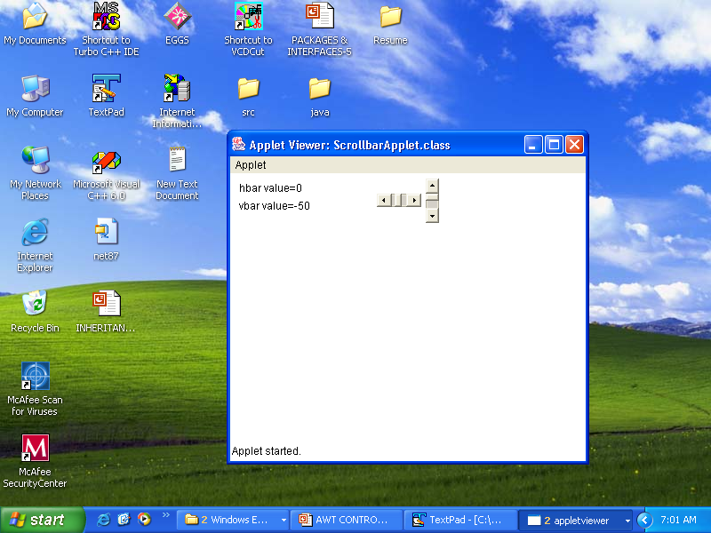

Slide 43
TextField
The TextComponent class provides the functionality for selecting and editing text.
Its two subclasses TextField and TextArea inherit this functionality to implement single line or multiple lines of text, respectively.
The text in the components can be read only or editable.
The TextField class implements a single line of optionally editable text.
The size of the text field is measured in columns.
Some initial text and a preferred size can be specified when a text field is created.

Slide 44
Constructors:
TextField()
TextField(int columns)
TextField(String str)
TextField(String str, int columns)
Methods:
String getText
void setText(String str)
String getSelectedText()
void select(int startIndex, int endIndex)
boolean isEditable()
void setEditable(boolean flag)
void setEchoChar(char ch)
boolean echoCharIsSet()
char getEchoChar()

Slide 45
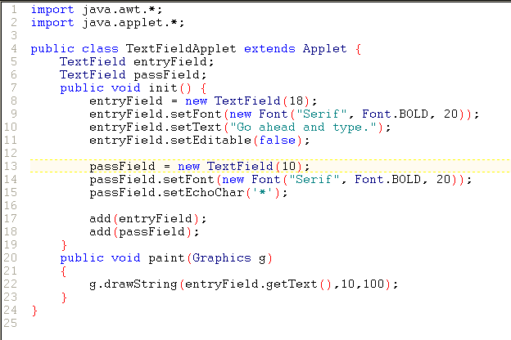

Slide 46
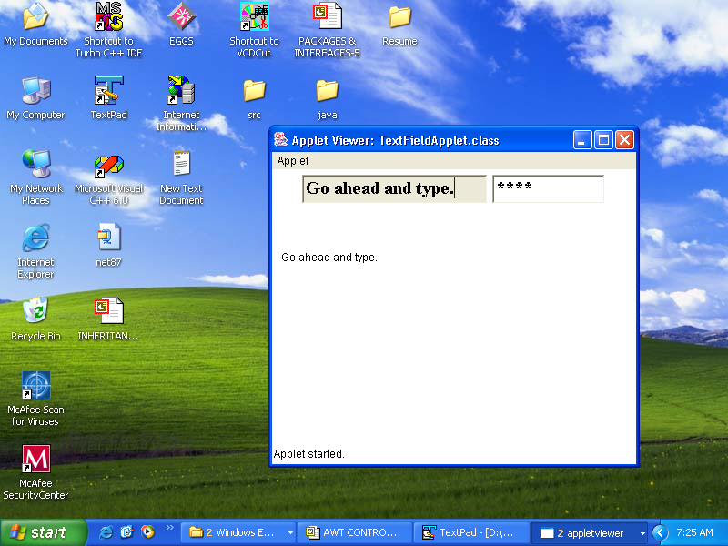

Slide 47
TextArea
TextArea represents multiple lines of text.
Constructors:
TextArea(int rows, int columns)
TextArea (String text, int rows, int columns)
Constructs a new text area with the specified text, and with the specified number of rows and columns.
TextArea(String text, int rows, int cols, int scrollbars)

Slide 48
scrollbars can have the following values:
SCROLLBARS_BOTH
SCROLLBARS_VERTICAL_ONLY
SCROLLBARS_HORIZONTAL_ONLY
SCROLLBARS_NONE

Slide 49
TextArea being a subclass of TextComponent, it supports getText(),setText(),getSelectedText(),select(), isEditable() and setEditable() methods.
The following methods are also used:
void append(String str)
Appends the string str to the end of the current text.
void insert(String str, int index)
Inserts the string str at the specified index.
void replaceRange(String str, int startIndex, int endIndex)
Replaces the characters from startIndex to endIndex-1.

Slide 50
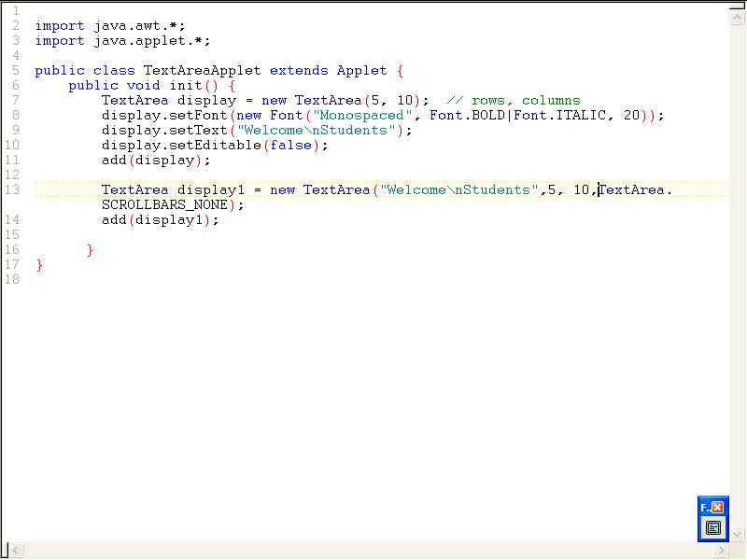

Slide 51
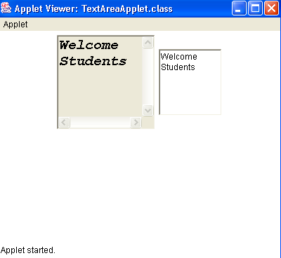

Slide 52
Canvas
A canvas class provides the ability to construct GUI components.
The class doesn’t have any default graphical representation, or any event handlers of its own.
It inherits these capabilities from its superclass Component.
The canvas class is usually subclassed to construct customized GUI components consisting of drawings or images and can handle user input events relating to mouse and keyboard actions.
Its paint method is usually overridden to render graphics in the component.

Slide 53
import java.awt.*;
import java.applet.*;
public class CanvasApplet extends Applet {
public void init() {
DrawingRegion region = new DrawingRegion();
add(region);
}
}
class DrawingRegion extends Canvas {
public DrawingRegion() {
setSize(150,150);
}
public void paint(Graphics g) {
g.drawRect(0,0,149,149);
g.drawString("A 150x150 Canvas", 20,20);
}
}

Slide 54
